Slide 1
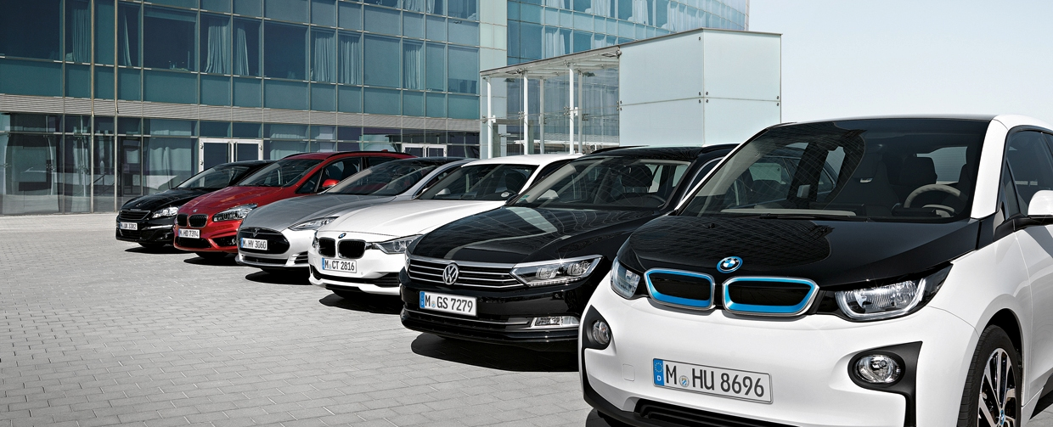

Marketing Automation for Network4cars
Author - Mausam Kumari

Slide 2
Automation Process
Scenario
Weekly email with mix of all offers is sent along with additional Marketing special deals.
Bottleneck
Optimization of the whole process.

Slide 3
Solution
Synchronize emails sent by Sales rep- History intact.
Frequency of the emails should be uniform. Eg. Monthly Newsletter, Bi-weekly offers
Define Segments and send segment based communication. Eg: Used Cars, Best Discounts, Sedan, Luxury, SUV, Quick Delivery etc.
Notes:
Instead of sending all the promotions in one email We can send them according to the segments apart from the searchable options present on the website..

Slide 4
Optimising Customer Emails
Analyse Purchase history.
Drive a pattern
Tag segments to the user profile.
Create reports/lists
Eg: Customers who have bought Used BMWs in the past one year.
Customers who have bought New cars at best Discount in the last quarter.
Send related communication. Eg: promotional email
Notes:
Using previous sales history we can attach a segment(s) to a customer and send related offers stating “We know you love to buy SEGMENTED cars, so here are few more.” In case the customer does not click on any links after arriving on the landing page , and this happens for 3 times we can send another category. Or we can send him a short survey along with the email asking “want to see different cars? Tell us your preference” Both the information should be captured and processed to CRM and the customer preference must be set accordingly so that he receives communication to his suitability.

Slide 5
Cont.
Bottleneck: - No action on promotional emails?
Solution: Change the offer category.
Still no action?
Send a survey or call him to check if this is the information he wants to see.
(further information is shared in Case 3)
The information he shares should be attached to his profile so that suitable communication reaches him.
Make sure the communication is responsive to other devices.
Do not forget the Unsubscribe button but it shouldn’t be highlighted at all.

Slide 6
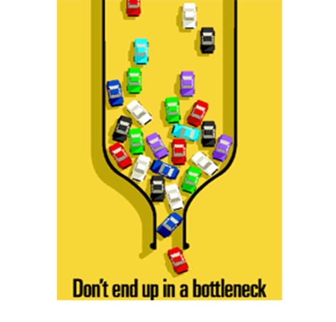



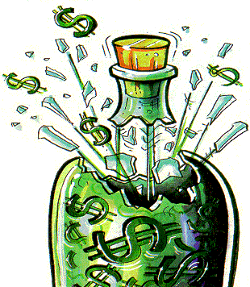
No Action on emails
Win Customers
Attach all information to customer profile.
Change offer Category
Send a Survey

Slide 7
Optimising Prospect Emails
Activate Lead scoring to know categories he is interested in. Use Pardot Forms with 4-6 fields.
Save Previous search or let him create one now with subscribe set to his email.
JavaScript Tracking on visited pages can indicate if a prospect is Sales ready.
Create a Drip Program – Explained in Section 3.

Slide 8
Customer Journey
Current Scenario: No communication after the sales except emails which contain new possible deals.
Bottleneck: Defining a customer journey. Post sales Communication to bring in customer Loyalty.

Slide 9
The Customer Journey
Learn
Try
Buy
Propagate
Discover
Notes:
Wide gap between Buy and Propagate which can be filled in by better communication. Most companies loose repeat customers because they lacked in post sales communication or better say customer service.

Slide 10
The customer stage - Buy stage.
Desired result – Repeat customer and propagates.
“Send communication which helps the customer instead which helps you. Sales will follow” – My ex-colleague who is the CEO of a Marketing Automation Company now.
Notes:
The customer in this case is either in or has crossed the Buy stage. We need to ensure that he buys again and propagates about our services. The communication should be compelling.

Slide 11
Types of Post Sale Communication
Feedback Forms: These are strong examples that you take customer feedback seriously.
Customer Care: Ask them about the difficulties they faced and if we can help them in the future.
Information about best offers: Make them feel privileged by sending fast and first communication about best deals and offers.
Referral Bonus: This will help spreading word of mouth if the customer is also benefitted. He can receive some discount on his next purchase when his referral makes a purchase.
Basic emails like Confirmation email, Thank you email and personalized Birthday/anniversary emails.
Notes:
Very Basic emails like Sale Confirmation, Thank you email , etc are not mentioned here. Personalizes emails for Birthdays or anniversaries, favourite sports team are also good.
Customer Care – Email followed by a phone call. Empathy is important.
Sometimes customers want to share something but are not getting time or moment so your email might remind them]
Reviews – Overwhelmed people share reviews.

Slide 12
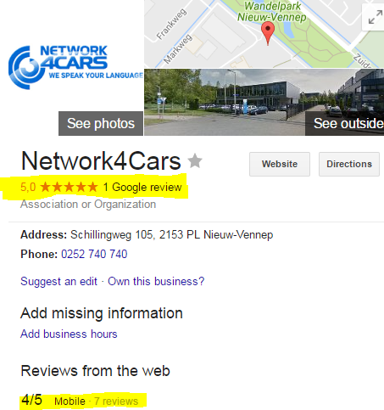
Cont.
Ask for Reviews: Happy customers will give good reviews and it can be showed on our website and moves your page up in organic search.

Slide 13
Newsletter: We can create newsletter about some simple topics which our customers might want to know more about like the Maintenance hacks, industry trends, tax changes, best car awards and latest industry news.
Push-Pull strategy : To align purchase based on customer choice.
Caution – Timeline your emails and do not send several emails at one time. Use Suppression List

Slide 14
Database
Current Scenario: 18000 contacts with around 5000 active.
Bottleneck: Identify potential customers and who are not-interested.

Slide 15
Solution
In B2B industry roughly 30% data decays every year. – SiriusDecisions estimate.
According to Pardot - Active prospects are prospects that have ever had at least one activity besides an email send, email open, email bounce, or opportunity. (not good indicators)
Notes:
These activities are excluded because they are not good indicators of a prospect's interest, or they are passive actions that the prospect didn't perform (like email bounces).

Slide 16
Measures to Ensure Database Hygiene
Drip Program: We can set up a drip program with a simple dynamic list and good emails to encourage our prospects .
Notes:
The end of the drip program will give us interested leads and the rest can be moved to Recyle Bin. Clarification: Recycle Bin keeps up the data without increasing your database. Whenever a Contact who was in your recycle bin makes an activity on your website by using the same email address as is in the CRM he is moved back to Active Prospect.
You can chose the inactive tiem frame eg: contacts who are inactive from 1 year.
Instead of Drip Program you can use Engagement Studio.

Slide 17
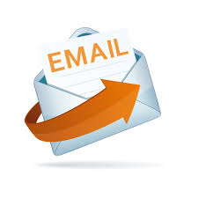




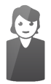
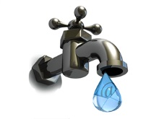
1. First ever email : Blog link
3nd Email : Discount
4th Email : Last offer
2nd Email : Best offer
5 days
7 days
Pause for 5 days
Customer clicked on link
Customer clicked on link
Notify Sales Rep
Assign to new Drip
Notes:
Elaborate Recycle bin.

Slide 18
Permission Pass: Permission pass is a one time email sent to reconfirm your interested prospects with a ‘Opt in”.
Clearing Hard bounce : We don’t realize.
Javascript Tracking: Add scores to the pages a customer/prospect might visit. This can be done using JavaScript when we add the parameter piPoints = “10”; before the piTracker() function before the <! or after piCId variable.
Assign negative points to visitors visiting Career page or less points to other non-sales related page.
Sales Alert – Alert to the sales rep as soon as a contact moves to Active.
Notes:
Permission Pass: We can create a form or a redirect link with “Opt in to receive future communication” and sent it to all the contacts. After a waiting period of 7-14 days we can run an automation to establish Opt in and Opt out in the database. All the data can be synced to Salesforce and other CRMs. This will leave us with an interested list.
Hard Bounce: Many times we don’t realize that few contacts have hard bounce email address while the phone number is still reachable. The email address can be edited by the Sales rep if the contact is still interested and the email might have moved or changed.

Slide 19
Pardot Best Practices
Pardot allows for 5 soft bounces and then moves a contact to “Opt out” untill the contact completes an action(filling a form, survey, action on website) or is added manuallly back.
Pardot Automatically “Opts Out”Hard Bounces.
Unsubscribe is Taken seriously by Pardot and is automated.
Pardot’s automation rule’s are set according to email best practises.

Slide 20
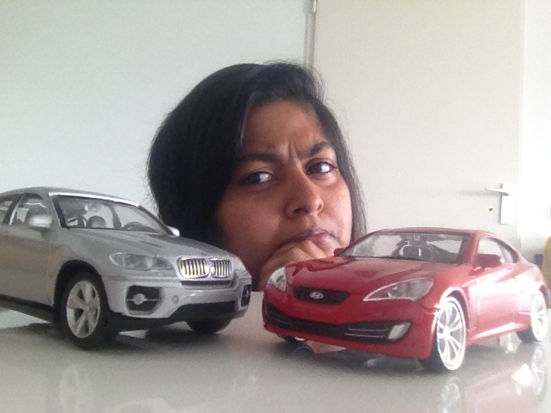

Cars on my Mind!

Slide 21
Thank you.
Questions /Doubts/Clarifications!
Sample - Network4Cars App Link

